Slide 1
Linear Regression
Prof. Andy Field

Slide 2
Aims
Understand linear regression with one predictor
Understand how we assess the fit of a regression model
  Total sum of squares
  Model sum of squares
  Residual sum of squares
  F
  R²
Know how to do regression using R
Interpret a regression model

Slide 3
What is Regression?
A way of predicting the value of one variable from another.
  It is a hypothetical model of the relationship between two variables.
  The model used is a linear one.
  Therefore, we describe the relationship using the equation of a straight line.

Slide 4
Describing a Straight Line
b_{i}
  Regression coefficient for the predictor
  Gradient (slope) of the regression line
  Direction/strength of relationship
b₀
  Intercept (value of Y when X = 0)
  Point at which the regression line crosses the Y-axis (ordinate)

Slide 5
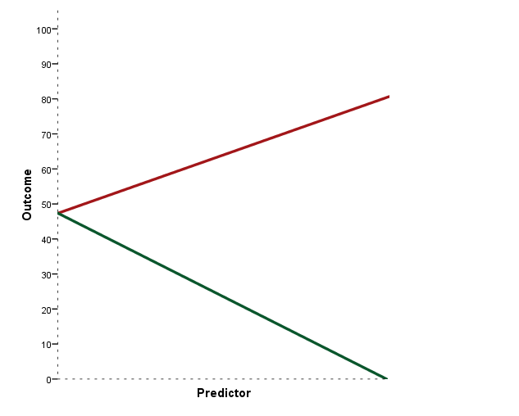
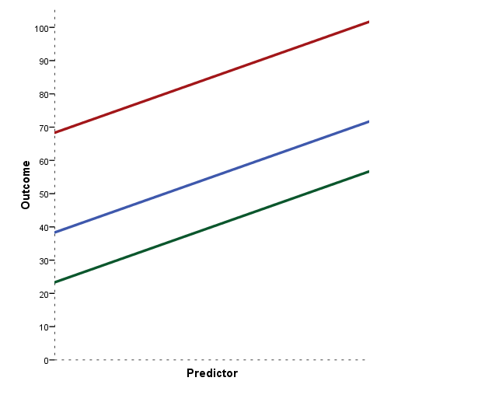
Intercepts and Gradients

Slide 6
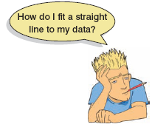
The Method of Least Squares
This graph shows a scatterplot of some data with a line representing the general trend. The vertical lines (dotted) represent the differences (or residuals) between the line and the actual data

Slide 7
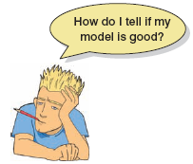
How Good Is the Model?
The regression line is only a model based on the data.
This model might not reflect reality.
  We need some way of testing how well the model fits the observed data.
  How?

Slide 8
Sums of Squares
Diagram showing from where the regression sums of squares derive

Slide 9
Summary
SS_{T}
  Total variability (variability between scores and the mean).
SS_{R}
  Residual/error variability (variability between the regression model and the actual data).
SS_{M}
  Model variability (difference in variability between the model and the mean).

Slide 10
Testing the Model: ANOVA
SS_{T}
Total Variance in the Data
SS_{M}
SS_{R}
Improvement Due to the Model
Error in Model
If the model results in better prediction than using the mean, then we expect SS_{M} to be much greater than SS_{R}

Slide 11
Testing the Model: ANOVA
Mean squared error
  Sums of squares are total values.
  They can be expressed as averages.
  These are called mean squares, MS.

Slide 12
Testing the Model: R²
R²
  The proportion of variance accounted for by the regression model.
  The Pearson Correlation Coefficient Squared

Slide 13
Regression: An Example
A record company boss was interested in predicting record sales from advertising.
Data
  200 different album releases
Outcome variable:
  Sales (CDs and downloads) in the week after release
Predictor variable:
  The amount (in units of £1000) spent promoting the record before release.

Slide 14
Doing Simple Regression Using
R Commander

Slide 15
Regression in R
We run a regression analysis using the lm() function – lm stands for ‘linear model’. This function takes the general form:
  newModel<-lm(outcome ~ predictor(s), data = dataFrame, na.action = an action))

Slide 16
Regression in R
  albumSales.1 <- lm(album1$sales ~ album1$adverts)
or we can tell R what dataframe to use (using data = nameOfDataFrame), and then specify the variables without the dataFrameName$ before them:
  albumSales.1 <- lm(sales ~ adverts, data = album1)

Slide 17
Output of a Simple Regression
We have created an object called albumSales.1 that contains the results of our analysis. We can show the object by executing:
  summary(albumSales.1)
  >Coefficients:
  Estimate Std. Error t value Pr(>|t|)
  (Intercept) 1.341e+02 7.537e+00 17.799 <2e-16 ***
  adverts 9.612e-02 9.632e-03 9.979 <2e-16 ***
  Signif. codes: 0 ‘***’ 0.001 ‘**’ 0.01 ‘*’ 0.05 ‘.’ 0.1 ‘ ’ 1
  Residual standard error: 65.99 on 198 degrees of freedom
  Multiple R-squared: 0.3346, Adjusted R-squared: 0.3313
  F-statistic: 99.59 on 1 and 198 DF, p-value: < 2.2e-16

Slide 18
Using the Model

